Slide 1
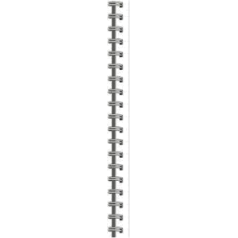



Resume Project Challenge
Presenter:
Mayank Bhatt
Challenge #6:
Provide Insights to the Marketing Team In Food & Beverage Industry.
Company Name:
CodeX
Tools Used:
MySQL
Power BI

Slide 2
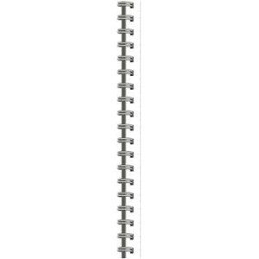

About CodeX:
CodeX is a German beverage company that is aiming to make its mark in the Indian market.
Background:
A few months ago, Codex launched its energy drink in 10 cities of India.
With the launch of their energy drink the marketing team at CodeX has conducted a survey in those 10 cities and received results from 10k respondents.
The marketing team is now aiming to analyze the survey responses to increase their brand awareness, market share and product development.
Objective:
To create a dashboard for the marketing team at Codex that facilitates a deeper understanding of the Indian market, enabling data-driven decision-making to effectively impact the market.

Slide 3
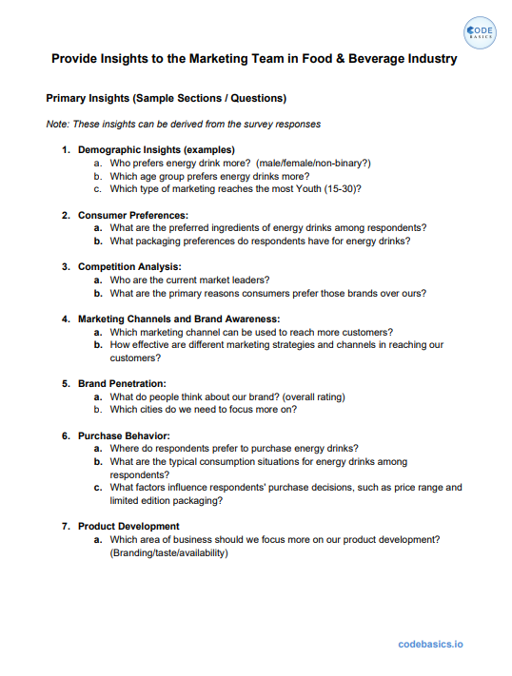
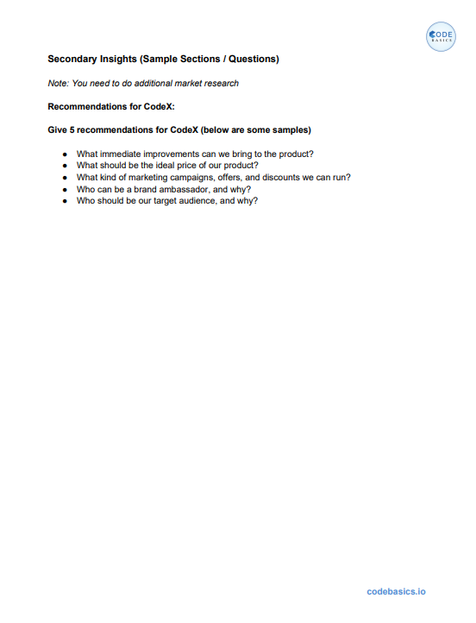


Slide 4

Introduction To Energy Drinks
Energy drinks are beverages that contain stimulant compounds, primarily caffeine, aimed at providing mental and physical stimulation.
Energy drinks may or may not be carbonated and often contain additional ingredients such as sugar, sweeteners, herbal extracts, taurine, and amino acids.
The primary function of energy drinks is to provide a temporary boost in energy levels and combat fatigue.
The high caffeine content in energy drinks can increase alertness, improve focus, and temporarily enhance physical performance.
Energy drinks are popular among students, professionals, athletes, and individuals seeking a quick pick-me-up or an energy boost during demanding activities.
While energy drinks can offer short-term benefits, it's important to prioritize overall health and well-being by getting adequate rest, maintaining a balanced diet, and staying hydrated.

Slide 5

Energy Drinks Market In India
The India energy drink market is projected to grow at a CAGR of 9.98% over the next five years.
Energy drinks are gaining popularity among millennials due to aggressive marketing campaigns targeting young consumers.
Increased urbanization, rising disposable income, and growing health consciousness among the Indian youth are driving the demand for energy drinks.
Demand for energy boosters in parties and clubs is accelerating the consumption of energy drinks in India.
The increasing trend of long and erratic working hours in India is also contributing to the rising demand for energy drinks as a means to combat fatigue and enhance productivity.
Manufacturers need to focus on teenagers and young adults as the primary market for energy drinks, presenting significant opportunities for the industry.

Slide 6
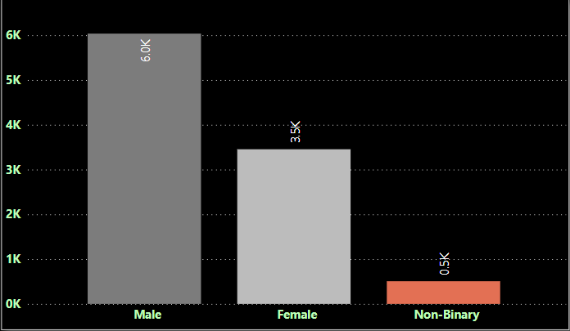
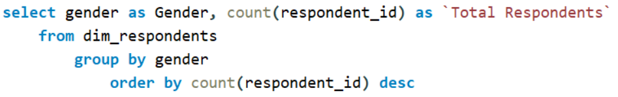
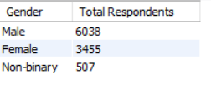
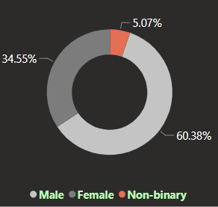

Demographic Insights
1. Who prefers energy drink more? (male/female/non-binary?)
SQL Query:
Output:
Energy drinks are more popular among the male population, followed by females and the non-binary population.

Slide 7
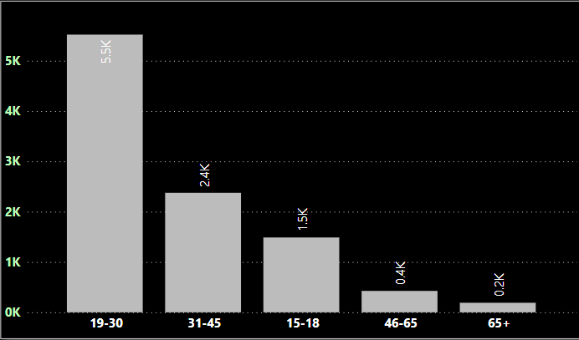
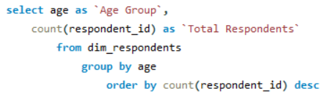
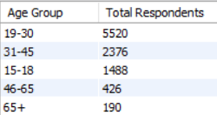
Demographic Insights
2. Which age group prefers energy drinks more?
SQL Query:
Output:
The age group "19-45" has the highest number of consumers, and it is crucial to target this consumer segment more effectively.

Slide 8
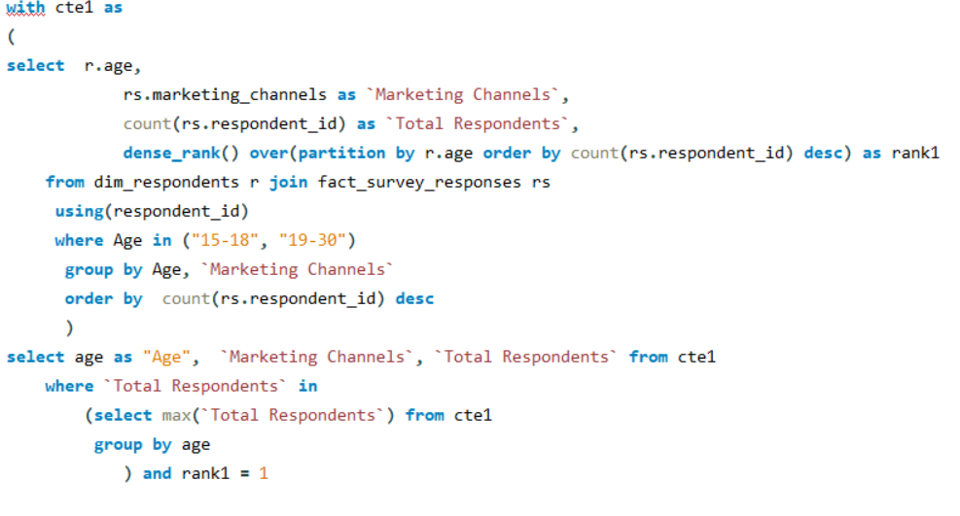
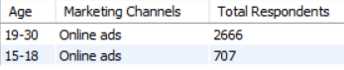
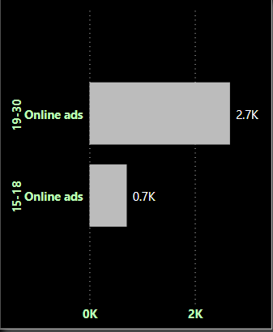
Demographic Insights
3. Which type of marketing reaches the most Youth (15-30)?
SQL Query:
Output:
Online advertising stands as the most popular and effective channel to engage with young customers.

Slide 9
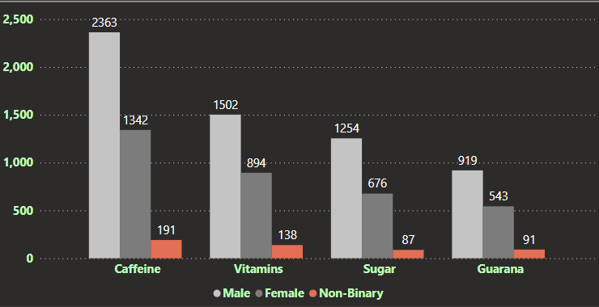
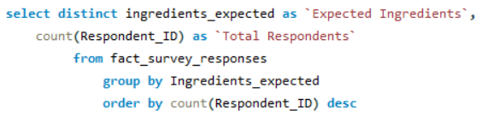
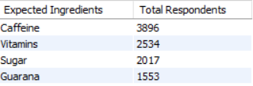
Consumer Preferences
1. What are the preferred ingredients of energy drinks among respondents?
SQL Query:
Output:
Caffeine is the most preferred ingredient among all genders, followed by vitamins, sugar, and Guarana.

Slide 10
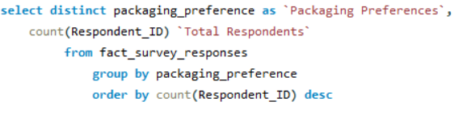
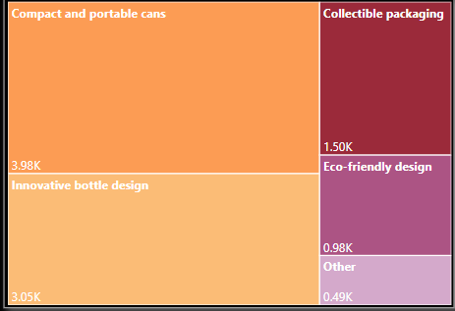
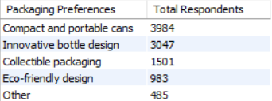
Consumer Preferences
2. What packaging preferences do respondents have for energy drinks?
SQL Query:
Output:
Cans and PET bottles are the most popular packaging preferences among consumers due to their convenience in terms of portability and aesthetic appeal. They are not only easy to carry but also provide a stylish and visually appealing look when held in one's hands.

Slide 11
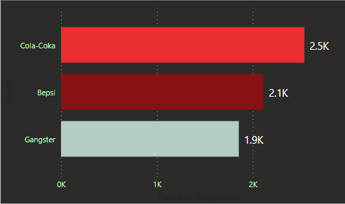
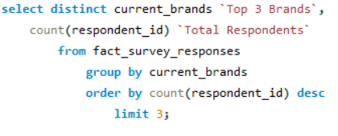
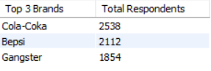
Competition Analysis
1. Who are the current market leaders?
SQL Query:
Output:
Cola-Coka, Bepsi, and Gangsters are the current market leaders in the energy drinks business.

Slide 12
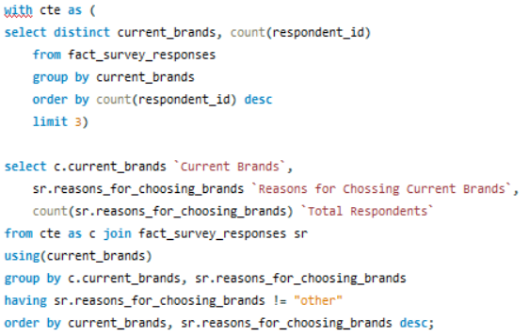
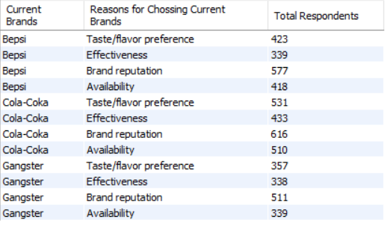
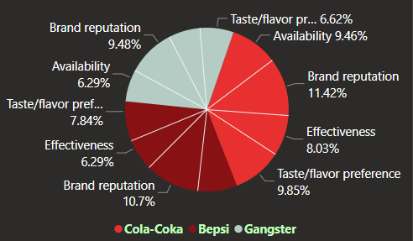
Competition Analysis
2. What are the primary reasons consumers prefer those brands over ours?
SQL Query:
Output:

Slide 13
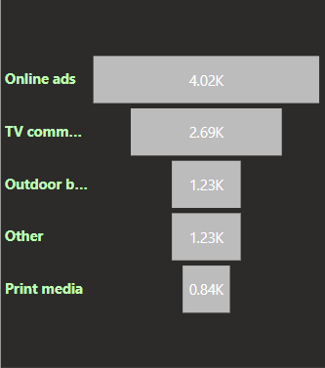
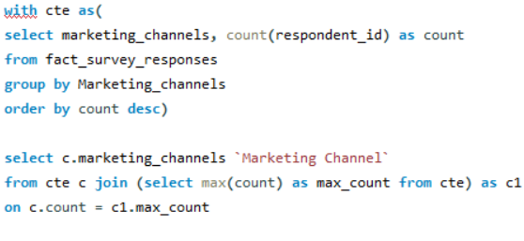
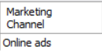
Marketing Channels and Brand Awareness
1. Which marketing channel can be used to reach more customers?
SQL Query:
Output:
The online channel is the most effective marketing strategy for promoting the brands among youths.

Slide 14
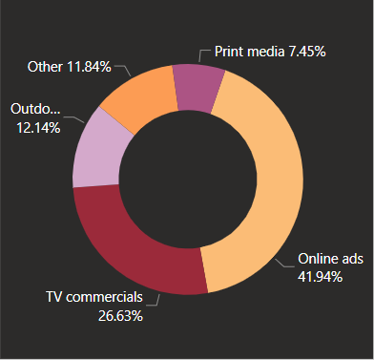
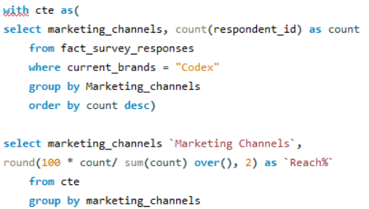
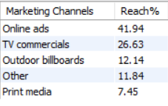
Marketing Channels and Brand Awareness
2. How effective are different marketing strategies and channels in reaching our customers?
SQL Query:
Output:
The online channel is the most effective marketing channel for the given set of respondents, followed by TV commercials and Outdoor Billboards

Slide 15
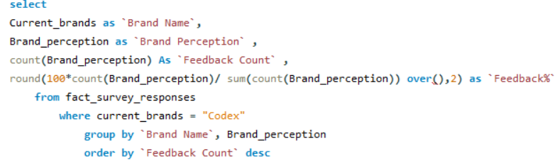
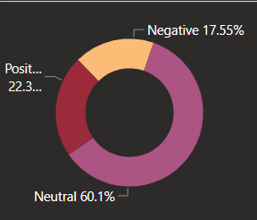
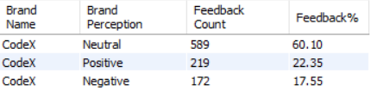
Brand Penetration
1. What do people think about our brand? (overall rating)
SQL Query:
Output:
Most of the respondents have neutral feedback about Codex. However, Codex can implement marketing strategies to convert respondents with neutral feedback into positive customers.

Slide 16
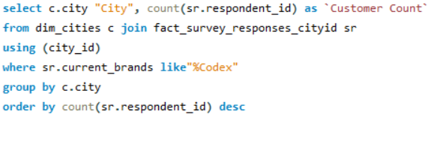
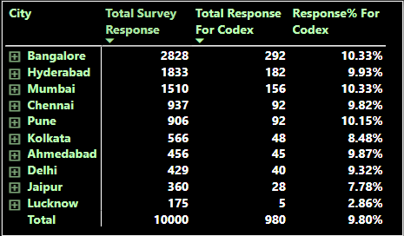
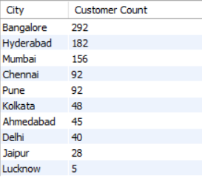
Brand Penetration
2. Which cities do we need to focus more on?
SQL Query:
Output:
Bangalore is leading the charts in terms of the number of respondents, followed by Hyderabad and Mumbai. CodeX should focus more on Hyderabad and Mumbai since they have tremendous potential for growth. Additionally, it would be beneficial to investigate the reasons behind Lucknow having the lowest number of respondents and work towards improving those numbers.

Slide 17
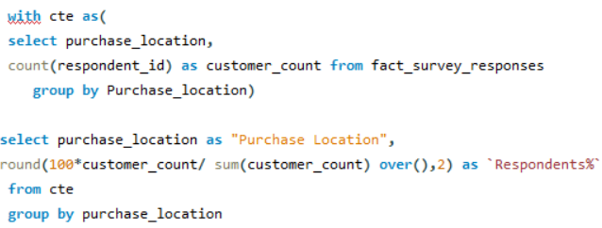
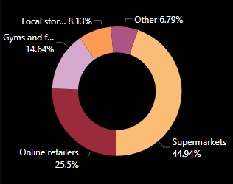
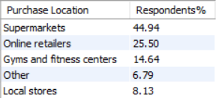
Purchase Behaviour
1. Where do respondents prefer to purchase energy drinks?
SQL Query:
Output:
In terms of purchase location preference, energy drink consumers clearly prefer buying their energy drinks from supermarkets and online stores the more.

Slide 18
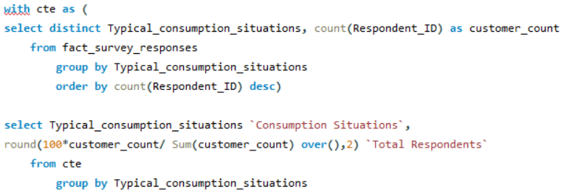
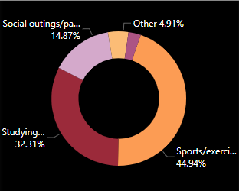
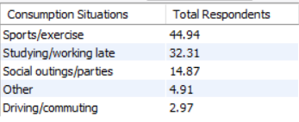
Purchase Behaviour
2. What are the typical consumption situations for energy drinks among respondents?
SQL Query:
Output:
In terms of purchase location preference, energy drink consumers clearly prefer buying their energy drinks from supermarkets and online stores the more.

Slide 19
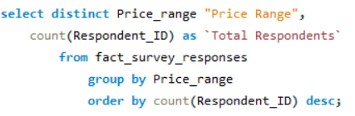
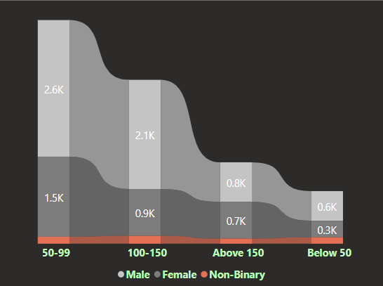
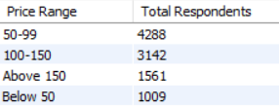
Purchase Behaviour
3. What factors influence respondents' purchase decisions, such as price range and limited edition packaging?
SQL Query:
Output:
The count of respondents exhibits an inverse relationship with prices. However, it is also evident that the total number of respondents is the lowest when the price range is below 50.
Continued On Next Page

Slide 20
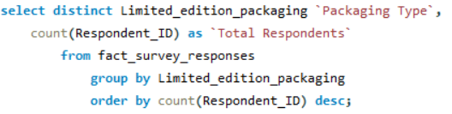
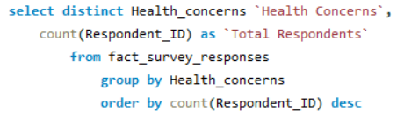
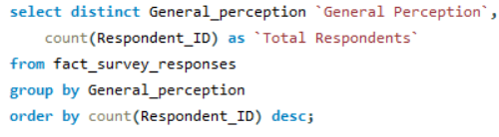



Purchase Behaviour
3. What factors influence respondents' purchase decisions, such as price range and limited edition packaging?
Other Factors Influencing Purchase Decisions
SQL Query:
Output:

Slide 21



Product Development
1. Which area of business should we focus more on our product development? (Branding/taste/availability)
SQL Query:
Output:
Brand reputation and product availability are two major factors attracting customer base.

Slide 22
Recommendations
To capitalize on its major consumer base of youth aged 15-30, Codex should consider offering compact and stylish cans at a higher price range to appeal to premium customers. Additionally, introducing innovative pet bottle designs at a lower price range would effectively target the medium and lower segments, leading to broader market reach and catering to diverse packaging preferences.
As Codex is still establishing its brand reputation in the Indian market, It can initially focus on a lower price range strategy. Introducing 250ml cans priced between 50-99 units would cater to the target audience of youth aged 15-30. Additionally, Codex should consider introducing a smaller variant in the form of 100ml pet bottles priced below 50 units to capture the lower price segment effectively. This approach will help Codex build brand awareness and attract a wider range of customers.
To effectively reach its major customer base, which falls within the age range of 15-30, Codex should primarily focus its marketing efforts on online channels such as social media platforms, YouTube ads, and music streaming platforms. These channels are highly popular among the target demographic and offer targeted advertising opportunities. Additionally, TV commercials can be incorporated into the marketing strategy, with a focus on news channels, sports channels, and reality TV shows, which cater to viewers aged 31-45. This multi-channel approach will ensure comprehensive coverage and engagement with the desired audiences.

Slide 23
Recommendations
To compete effectively against established energy drink brands, Codex can leverage innovative marketing campaigns that focus on green initiatives, attracting customers and enhancing brand reputation. One such campaign could involve encouraging customers to participate in a can recycling program. For instance, if a customer returns 10 empty cans to a store, they would be eligible to receive an extra can with their next purchase. This initiative promotes sustainability, incentivizes customer engagement, and distinguishes Codex as an environmentally conscious brand.
In addition to the green initiatives, another effective marketing strategy for Codex would be to offer discounts on bulk purchases of cans. By incentivizing customers to buy in larger quantities, Codex can encourage increased consumption and brand loyalty. This approach not only provides customers with cost savings but also creates a perception of value and convenience. Implementing bulk-buying discounts can attract both individual customers and potential business partnerships, contributing to Codex's market competitiveness and growth.

Slide 24
Recommendations
To effectively engage with the target customers aged 15-30, who are highly active on social media, Codex should consider collaborating with social media influencers and environmentalists who possess a strong online presence. These individuals can serve as powerful brand ambassadors, leveraging their influence to promote Codex and resonate with the desired audience. Additionally, as online ads have been identified as the most preferred marketing strategy according to survey data, allocating resources towards online advertising will ensure maximum reach and engagement. By incorporating these recommendations, Codex can successfully connect with its target customers and enhance brand visibility.
Lastly, it is important to acknowledge that energy drinks are increasingly being consumed as pre-booze beverages. In light of this trend, Codex should consider targeting bars and restaurants as potential distribution channels. By partnering with establishments that serve alcoholic beverages, Codex can tap into the pre-booze market segment and capture the attention of young consumers who seek an energy boost before a night out. This strategic approach expands Codex's reach and creates opportunities for brand exposure in social settings, further solidifying its presence in the energy drink market.

Slide 25
Thank You!

